Slide 1
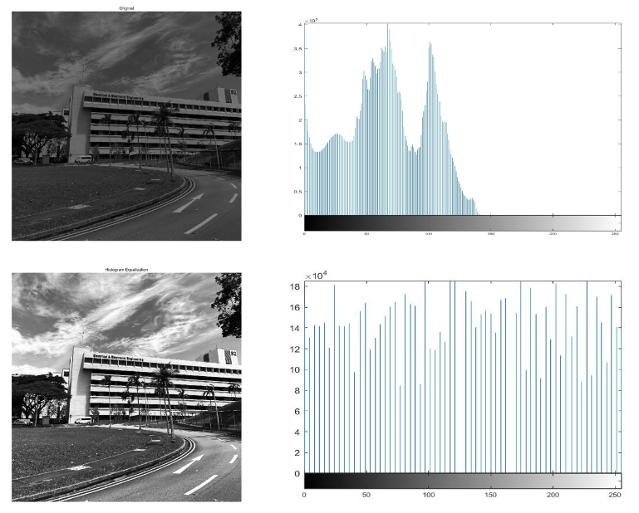
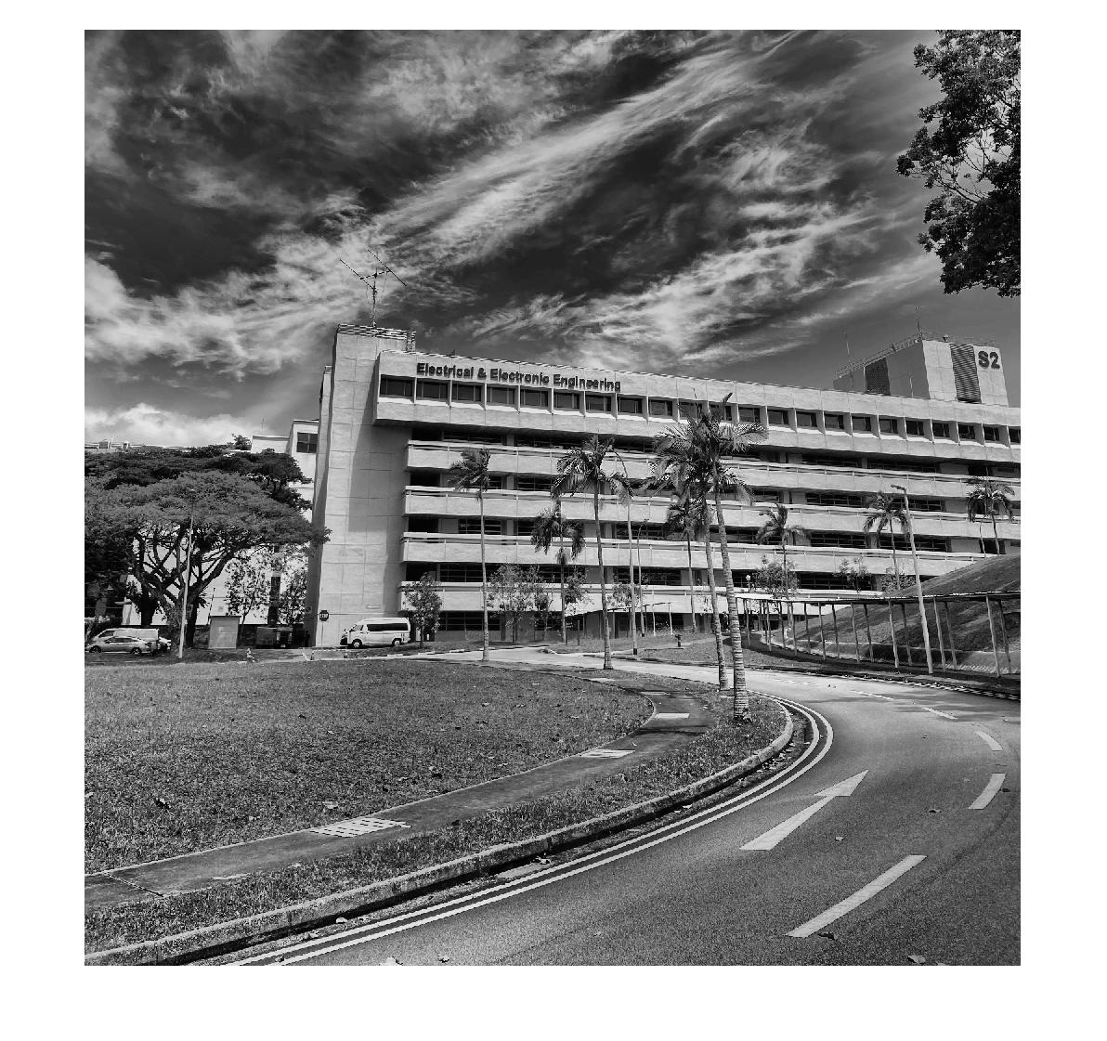
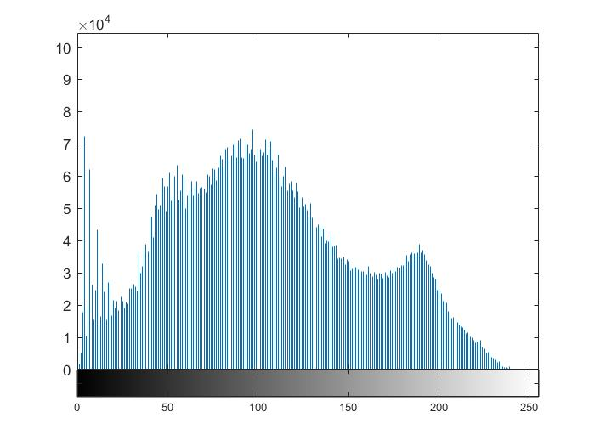
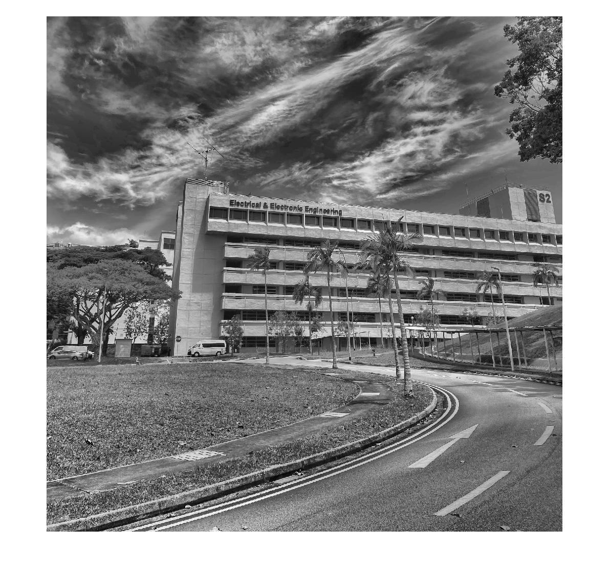
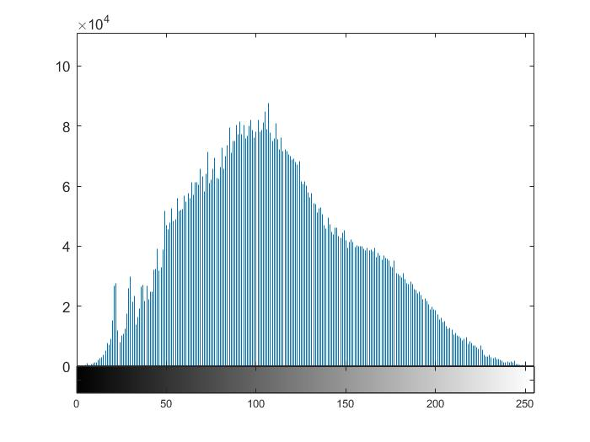
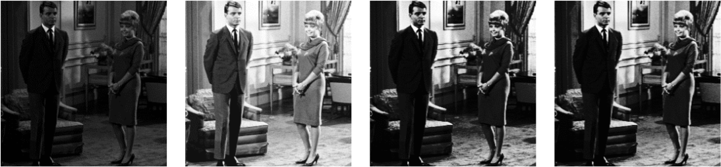
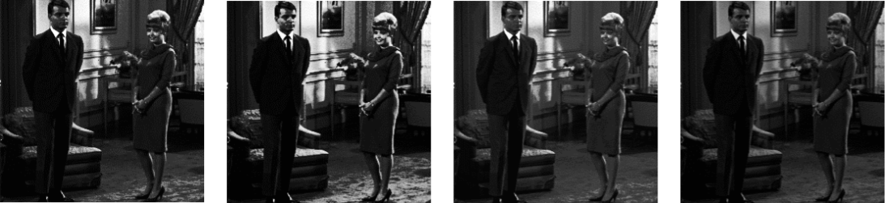
Original image
Original histogram
Image after AHE
AHE histogram
Transformed image
Transformed histogram
Image after CAHLE
CAHLE histogram
Fig. 1: Histogram equalization applied to low contrast image
Fig. 2: Adaptive Histogram equalization & CAHLE
(a) Original
(b) HE
(c) BBHE
(d) DSIHE
(e) RMSHE
(f) RSIHE
(g) MMBEBHE
(h) RSWHE-M
Fig. 3: Results of all methods tested on the image of ‘Couple’ [12]

